Slide 1
Effects of Ranolazine on Angina and Quality of Life Following PCI with Incomplete Revascularization -- The Ranolazine for Incomplete Vessel Revascularization (RIVER-PCI) Trial
Embargoed Until 10:45 a.m. ET, Tuesday, Nov. 10, 2015
Karen P. Alexander, Giora Weisz, Kristi Prather, Stefan James, Daniel B. Mark, Kevin J. Anstrom, Linda Davidson-Ray, Adam Witkowski, Angel J. Mulkay, Anna Osmukhina, Ramin Farzaneh-Far, Ori Ben-Yehuda, Gregg W. Stone, E. Magnus Ohman
For the RIVER-PCI Investigators ClinicalTrials.gov NCT01442038

Slide 2
Study Design
Patients with History of Chronic Angina AND Incomplete Revascularization After PCI
N=2600
1:1 Randomization
Strata: ACS vs. non-ACS, DM vs. non-DM
Ranolazine
1000 mg BID
245 sites
15 countries
Placebo
Standard Medical Therapy
Primary Endpoint
Ischemia-driven revascularization or Ischemia-driven hospitalization
Event driven
Minimum 1 Year Follow-up
Weisz G et al. Am Heart J 2013;166:953-959

Slide 3
Primary Endpoint
Ischemia-driven revascularization or ischemia-driven hospitalization
100
HR [95%CI] = 0.95 [0.82, 1.10] p-value = 0.48
90
Freedom from primary endpoint event (%)
80
70
Ranolazine
Placebo
60
0 3 6 9 12 15 18 21 24 27 30
Months since randomization
No. at risk
Ranolazine 1317 1164 1101 1018 945 891 813 500 266 134 30 Placebo 1287 1165 1098 1028 960 879 788 461 271 128 45
Weisz G et al. Lancet epub ahead of print Oct 15, 2015
Notes:
As was presented at TCT and published in the Lancet, there was no effect of ranolazine on the combined primary endpoint of ischemia-driven revascularization or hospitalization (or its individual components)

Slide 4
QOL Population
Overall Trial Population
(2,604)
1,317 to ranolazine
1,287 to placebo
92% QOL Population (2,389)
103 questionnaires invalid
7 questionnaires not done
97 questionnaires invalid
8 questionnaires not done
1,207 in QOL population
1,182 in QOL population
78% (1,864) complete data at all time points
Notes:
RIVER PCI randomized 2,604 to ran or plac, of these, 92% (or 2,389) completed valid quality of life questionnaires and were included in the QOL population

Slide 5
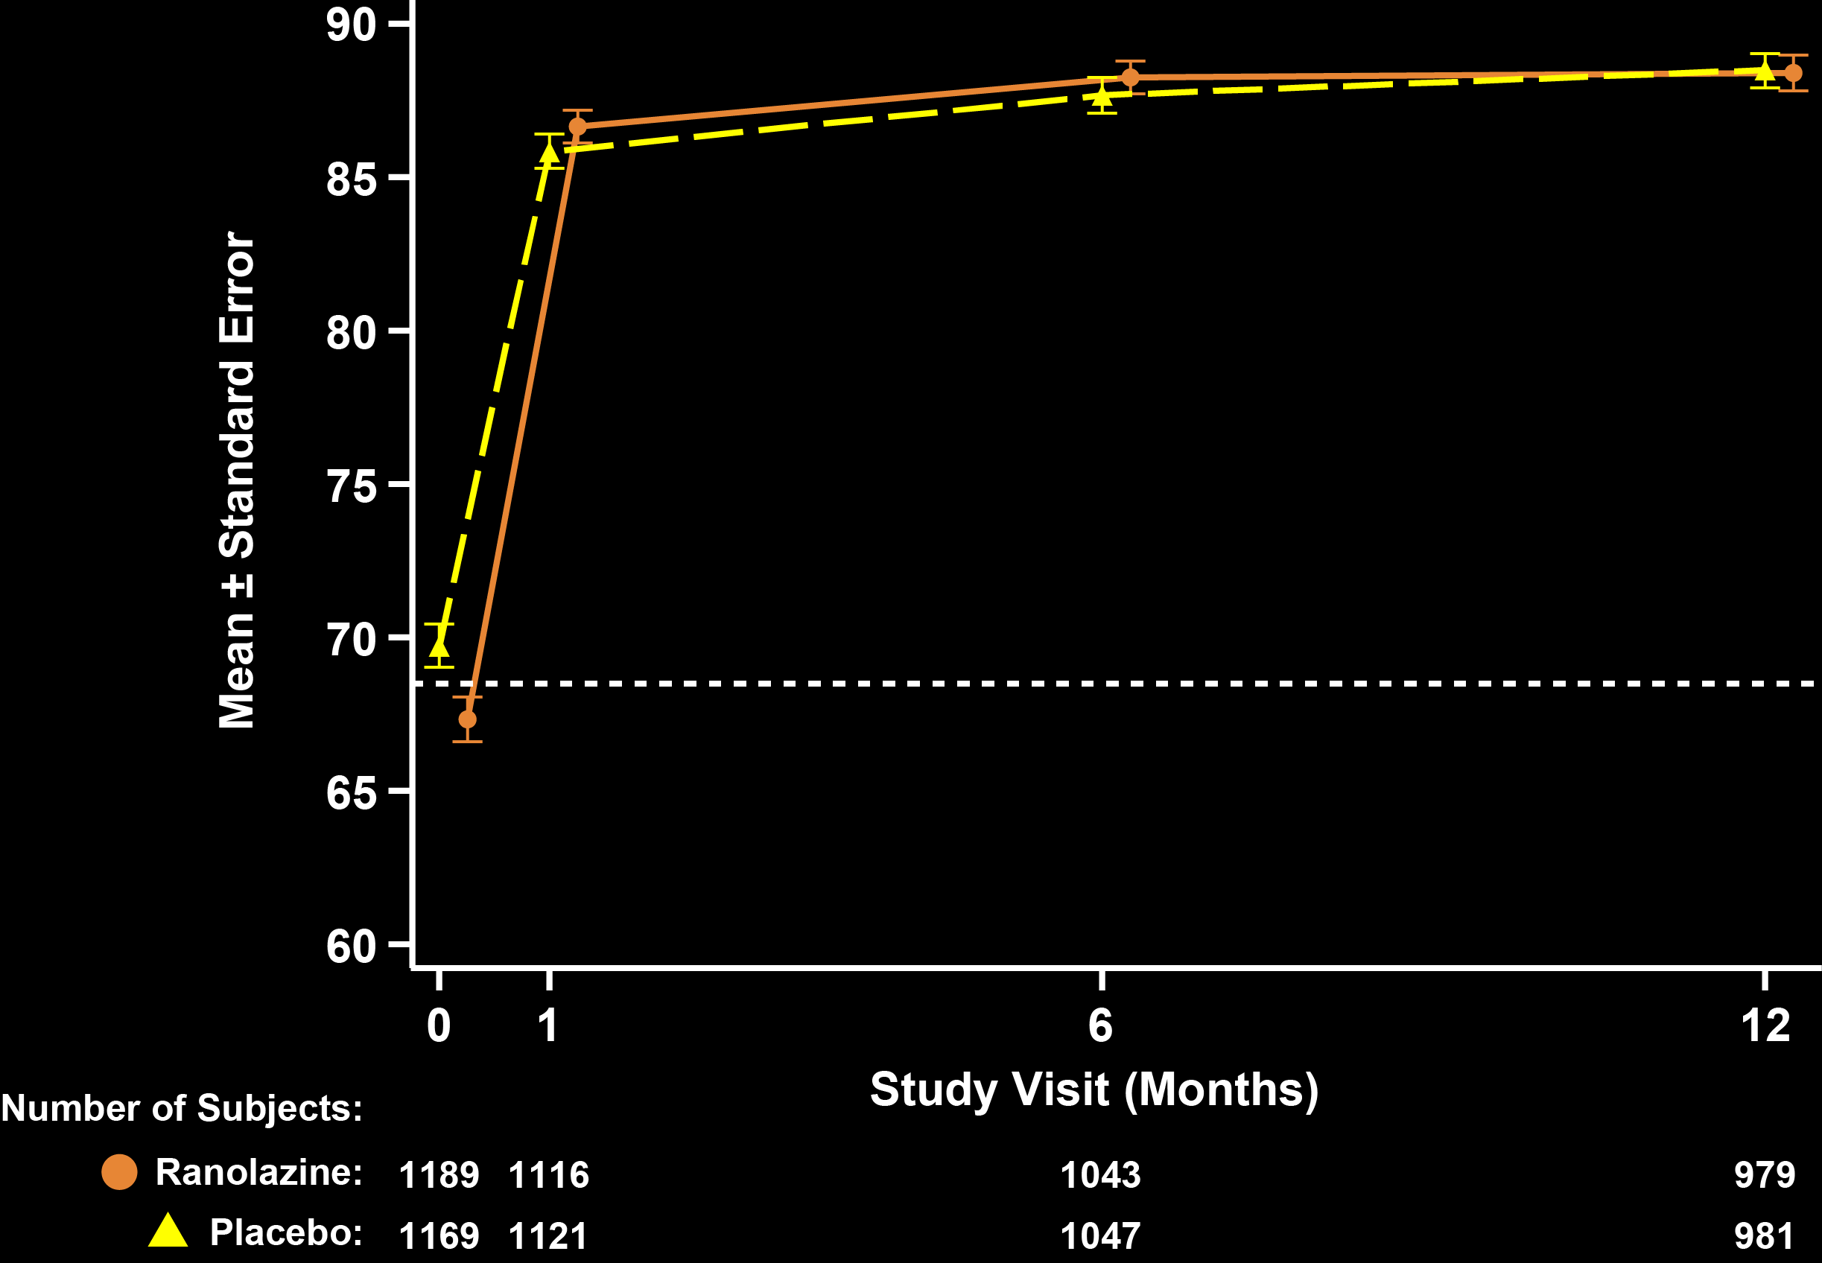
SAQ Angina Frequency
P = 0.23
P = 0.60
P = 0.62
88.2
88.4
86.6
88.5
85.8
87.7
P = 0.03
69.7
67.3
Notes:
Although slightly different at baseline, there was substantial improvement in SAQ angina frequency in both groups at 1 month that was sustained at 6 and 12 months. By 1 month, the majority had monthly angina or were angina free.

Slide 6
SAQ Angina Frequency
Mean Treatment Difference (Ranolazine – Placebo) – Adjusted for baseline
P = 0.06
P = 0.17
P = 0.51
Notes:
Mean treatment difference in SAQ AF showed a trend towards early benefit with ranolazine, but there were no significant differences between ran and plac at any follow up interval

Slide 7
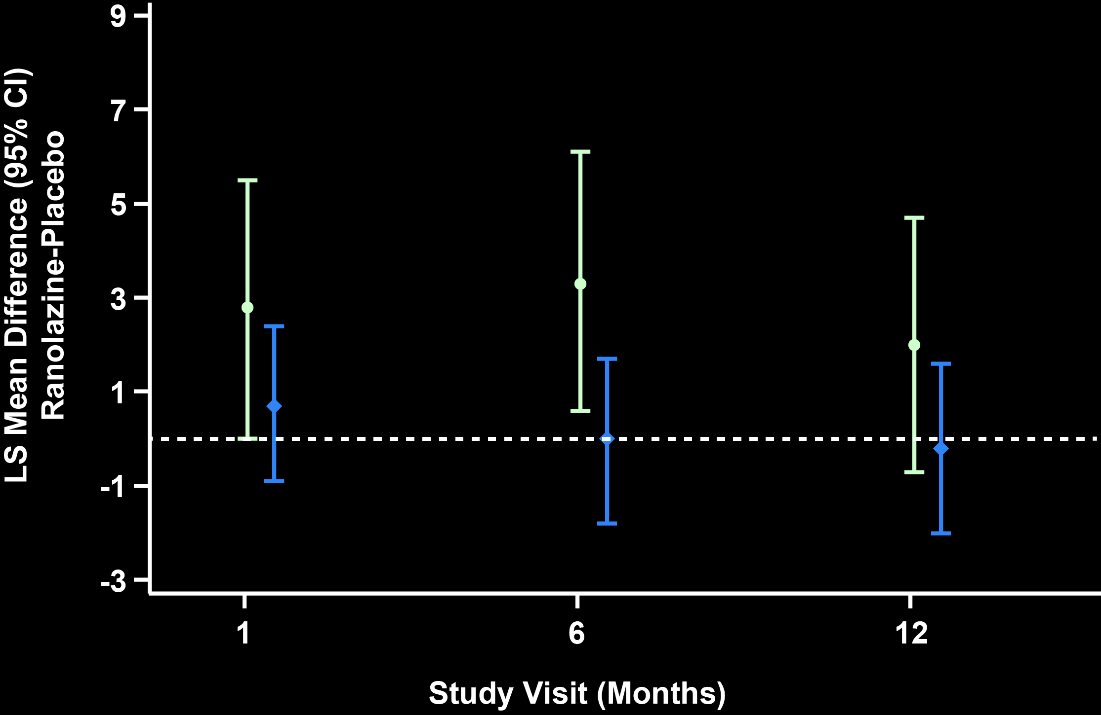
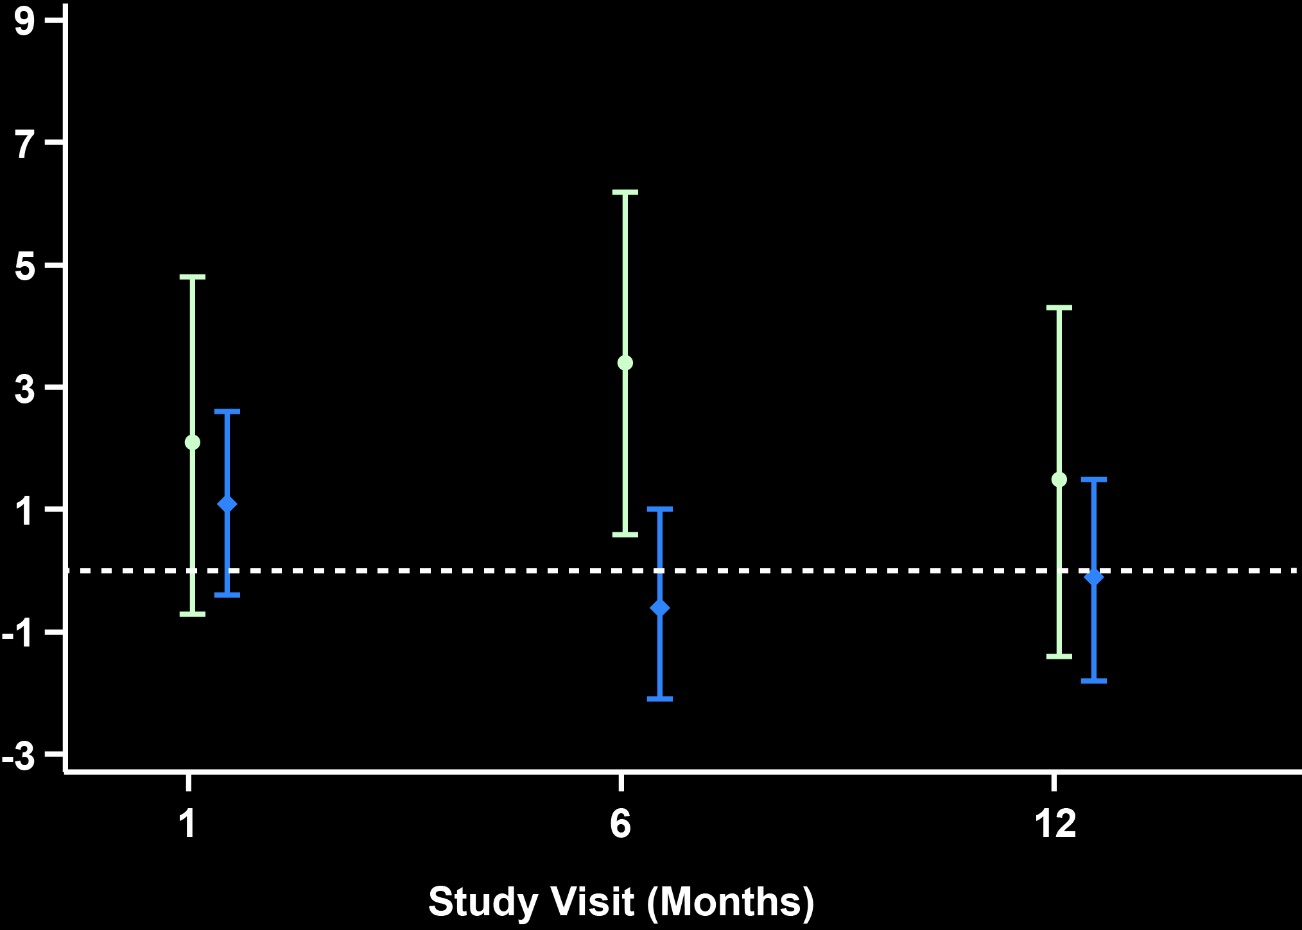
SAQ Angina Frequency – Diabetes and Baseline Angina Ranolazine – Placebo (Adjusted for Baseline Score)
Diabetes
No Diabetes
Daily/Weekly Angina at Baseline (≤60) Monthly/None Angina at Baseline (>60)
Interaction P=0.02
*
Interaction P=0.02
*
Notes:
Exploring these significant subgroup findings further….we noted that the effect was being driven by a treatment effect at 6 months, not evident at other time points (1 and 12 months).
Adjusted mean difference of SAQ angina frequency between treatment groups by subgroups at month 1, month 6, and month 12. SAQ angina frequency adjusted LS mean difference between arms at each time point controlling for baseline score and covariates for: (a) diabetes; and (b) angina frequency at baseline. For diabetes, treatment by subgroup interaction p-value: month 1 (0.21), month 6 (0.03), and month 12 (0.07); p=0.02 for LS mean treatment difference at month 6 among diabetics. For angina frequency, treatment by subgroup interaction p-value: month 1 (0.56), month 6 (0.01), and month 12 (0.52); p=0.02 for LS mean treatment difference at month 6 among patients with SAQ angina frequency score ≤60 at baseline. CI indicates confidence interval; DM, diabetes; LS, least squares; SAQ, Seattle Angina Questionnaire

Slide 8
Conclusions
Despite incomplete revascularization following PCI, there was no incremental benefit in angina or QOL measures by adding ranolazine in this angiographically-identified population
Significant and sustained improvements in angina were observed in both arms following PCI, with most patients having rare or no angina by one month
Additional research is needed to understand the relationship between patient-reported angina and ischemia-driven events
Notes:
Consistent with the overall neutral effect of ranolazine on the primary endpoint –
At month 1 - the majority (~84%) in both arms were angina free or had rare (monthly) angina
Marginal treatment effects were noted for DM and those with more frequent angina
Making it important to directly assess angina over time
Our findings highlight the difficulty in assessing the clinical significance of ICR, since patient-reported angina and QOL markedly improved
within 1 month after PCI. RIVER-PCI clarifies that prescribing ranolazine based on angiographic determinations alone
is unsupported, despite a high rate of recurrent events in this population over time.

Slide 9
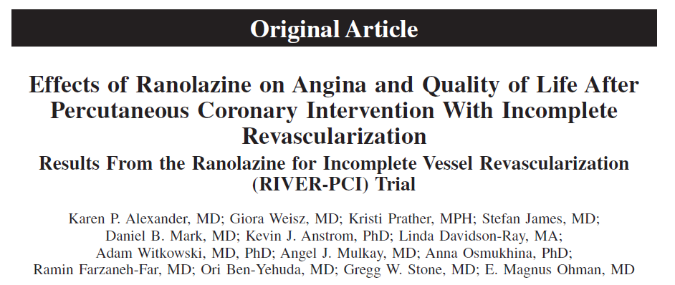
November 10, 2015 in Circulation
Notes:
Complete results of including full QOL and SAQ angina domains may be found on-line

